Slide 1
The Tfl Project
2.0

Slide 2
Analysis
Business
Why do we need it
Who uses it
What do we get out of it
Domain
What are we working with
What’s the data mean
Do we understand it
Does it work
Systems
Subsytems
Boundaries
Feeds and Interfaces
Technical
Tech stack and protocols
How fast
Scaling
Failover
Security
Logging
Requirements
What will it do
How fast
How many users
Availability
Security

Slide 3
Domain – The Tfl Data
Unit Test Project – TestTflObjects
LineClient.MetaModesAsync ()
Modes are tube, dlr, elizabeth-line, bus, walking, national-rail, many more…
LineClient.GetByModeAsync()
tube – bakerloo, central, etc…
elizabeth-line
Dlr
LineClient.RouteSequenceAsync()
Routes are sequences of stations on a line, in order of travel
Can routes skip stations?
Lines are NOT lines! The branch and join and one of them is even a circle!

Slide 4
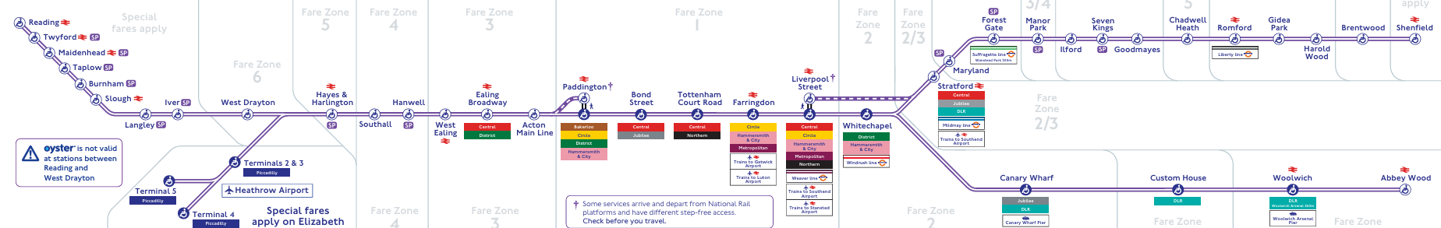

Slide 5
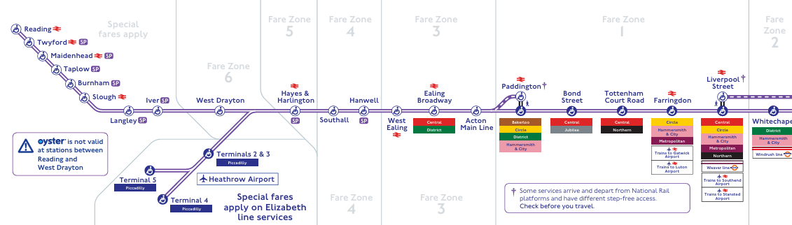
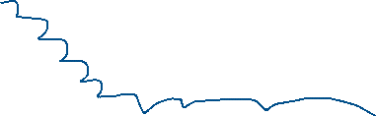



Slide 6
Requirement
What do we want to do?
So many options
One Idea:
Do a tube arrivals display
Select a platform:
Use a navigator, choose a line, then a station then a platform
Store a user’s favourites
Search by name
Display destination and predicted time of arrival, just like on the platform

Slide 7
Domain
Api Endpoint Inventory
LineClient
JourneyClient
Ids
Mode (so many modes we can work with),
Line (Are busses and national rail modelled in the same way?)
Station (Are bus stops the same as stations?)
Service Type
We can use Unit Tests to research and understand what is available

Slide 8
Line Structure Sub-Project
Requirement:
Users need to select stations at various points in the App:
Type and search - done
Show and click
Need a way to show the stations:
On a Map. Need to know coordinates and lines that connect stations.
In a List. Lines have as many as 40 stations, it’s not user friendly if the order of stations changes every time they look at a list
Order by A-Z – possible MVP solution
Order by “intuitive line order”, e.g. https://tubephotos.dannycox.me.uk/stationsbyline.html

Slide 9
Line Structure Project
What follows could be achieved by reusing TfL artwork and line diagrams
The purpose here is an exercise in analysis and algorithm design
We could also just do this manually, but we’re here to learn to program
TfL copyrights their artwork so we need permission anyway

Slide 10
Line Structure -> StationGraph class
In the TfL network, a “line” is not a line. (branches and circles)
The StationGraph class contains:
A DAG (Directed Acyclic Graph) to represent the “line”
A collection of StationNodes
Each StationNode has:
Name, Unique Id
Links to 0..many Previous StationNodes
Links to 0..many Next StationNodes.
In Computer Science, a Graph is a set of Nodes that are connected to each other by links (edges). Directed means that the edges are directional (in our case, we actually have links in both directions, so it’s 2 graphs in 1). Acyclic means that you cannot go in a circle and end up at the same point (which means we have to “break” the circle line)

Slide 11
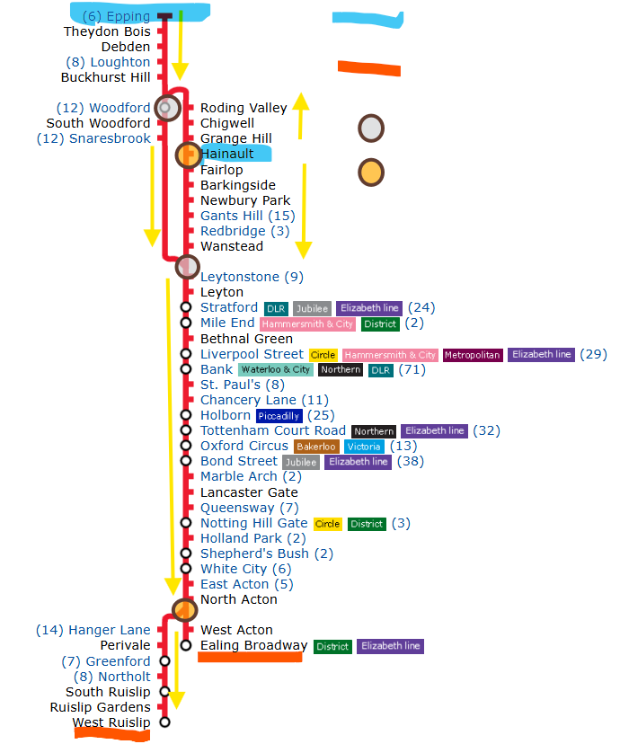
Head
Tail
Merge
Fork

Slide 12
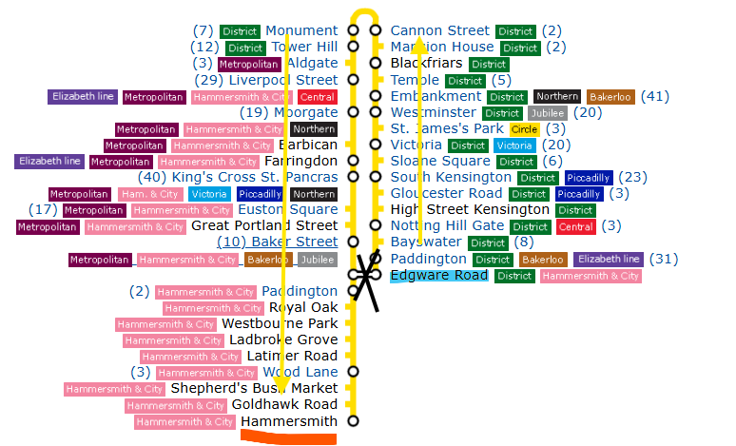

Slide 13
We need an algorithm
TfL gives us RouteSequences
Each line is made up of sequences of StopPoints (see Slide 5)
The StopPoints are in line travel order
The end of one sequence joins with the start of other sequence
Except at the start and end of the line
Together they make up the complete network
We need to build the Line Structure with our StationGraph class

Slide 14
Complication
TfL models the StopPoints on the RouteSequence using an entity that is smaller than what passengers think of as a station:
E.g. Liverpool Street is two StopPoints.
One for the Tube Station
One for the Network Rail Station
We want our “Stations” to be the merged entity of all StopPoints at one location.
Fortunately, these composite StopPoints have a ParentId.
So we will use StationId => ParentId ?? Id – it seems to works

Slide 15
1
2
7
First we need to build this
3
8
4
9
5
10
11
12
6
17
13
19
18
14
15
20
21
16

Slide 16
Start
And then transform it to this
1
7
2
Stable Order
1
2
3
3
8
4
5
4
6
9
7
5
8
10
9
11
10
12
11
6
17
12
13
13
19
18
14
14
15
15
20
16
17
21
18
16
19
Linear Connectivity diagram
20
21
End

Slide 17
ProcessSequence
(pred, node, BF)
BF = BroughtForward list
Node==END
return BF
IsMerge
IsFork
ProcessChain
Capture all passthru nodes until you reach an END, Merge or Fork (=currentNode)
BF = BF + passthru nodes
ProcessMerge
Use MergeProcessor to find the PendingMerge object for node.
Find out if this completes the merge or not
ProcessFork
foreach head in node.Next
sort our BF list and the BF lists from PendingMerge object (in desc order of size) and concatenate
ProcessSequence
(node, head, [])
Add the BF list to the PendingMerge object
ProcessSequence
(passthru.Last(), currentNode, BF)
BF = BF + result
BF = BF + [returns ordered by size]
lists =
processSequence
(node, head, lists)
return []
Return BF
Return BF
Return lists

Slide 18
1
START
[1,2,3,4,5]+[11,13] + [14,15]+[16]+[6]
1
2
2
3
2 saved data in pendingMerge
3
3 picks up pendingMerge data
And continues to 4
[1]
[1,2,3]
4
[1,2,3,4,5]
[1,2,3,4,5]+[11,13] + [14,15]+[16]+[6]
5
[]
11
[11]
[]
5
[]
13
[]
4
14
7
6
6
15
[14]
[11,13] + [14,15]
[6]
END
16
[11,13] + [14,15]+[16]
[11,13] + [14,15]+[16]+[6]

Slide 19
TOP
BOTTOM

Slide 20
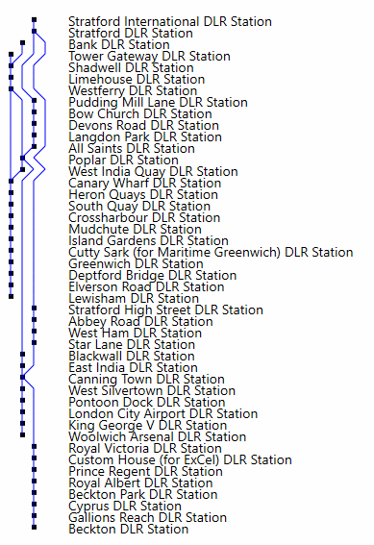
X = 0..3 columns for the blue lines and black squares
X = 5 start of each text label
x
0
Text Label (=(x,y) + “string” + NaptanId)
Option1: Generic format
Contains a collection of
Station text labels
Line segments
Black Squares
(this could be json or text)
Line segment (=(x,y) (x2,y2) + colour)
Black square (=(x,y))
Option2: React/js script
Contains the React code for
React elements
<Station name=“Canary Wharf” x=“5” y=“15” NaptanId=“”> text labels
<LineSegment colour=“Blue” x1=“2” y1=“15” x2=“3” y2=“16”>
<StationMark x=“3” y=“15”>
No of Stations
y

Slide 21
Option2: React/js script
Contains the React code for
React elements
<Station name=“Canary Wharf” x=“5” y=“15” id=“NaptanId”> text labels
<LineSegment colour=“Blue” x1=“2” y1=“15” x2=“3” y2=“16”>
<StationMark x=“3” y=“15”>
Write a react program to define
<Station> <LineSegment> <StationMarker>
Make up some mock data to show an example. Use a NaptanId from a Station so that you can click and hit an endpoint that retrieves some Predictions
Make the NetworkBuilder generate the real data using the real RouteSequenceAsync

Slide 22
START
1
2
3
4
5
6
7
8
9
10
11
12
13
14
15
16
17
18
19
20
21

